Slide 1
Sales Team Child Care
Andrew Pfeifer

Slide 2
Introduction
High Unemployment rates can case higher debt.
With these higher debts working families can be struggling.
It’s time to start providing Childcare services to employees.

Slide 3
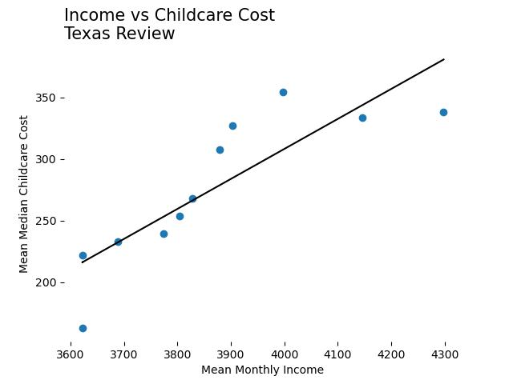
Income And Childcare
As income increases, so does childcare costs.
The trend continues upward with no sign of turning around.

Slide 4
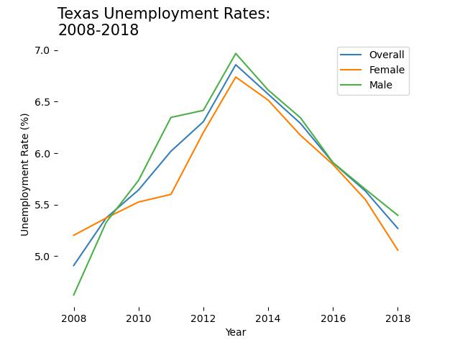
Texas Unemployment rates
Texas rates have dropped off since 2013.
From this time frame people may still carry debt.
Women have the lowest employment rates

Slide 5
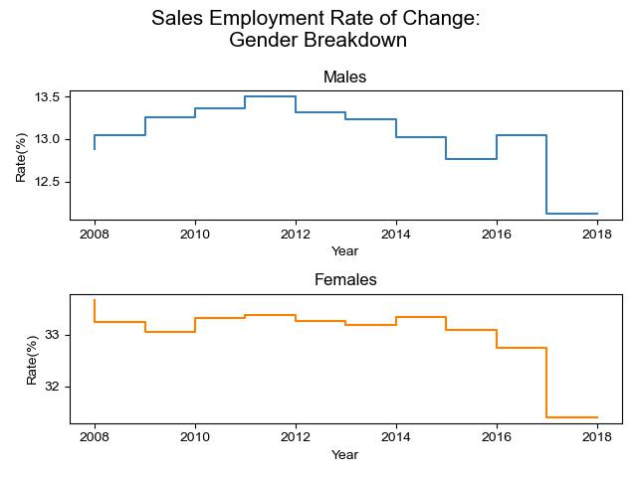
Sales Employees by Gender
Male employee rates fluctuate Frequently.
Female Employee rates are stable.
Both drop off in 2017 (around the start of covid)

Slide 6
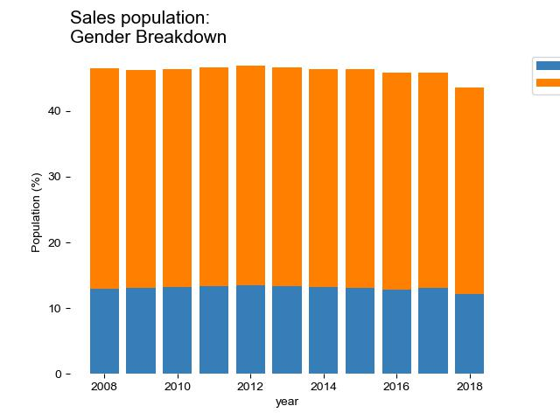
Employees by Gender
Most of the sales team is female.
Many of which can have children to apply for.

Slide 7
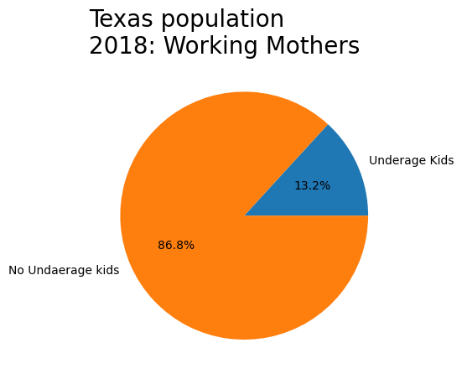
Employees with Kids
Less than 25% of Texas employees have children.
This includes single mothers.
Less than 20% of the staff should have children under 17.

Slide 8
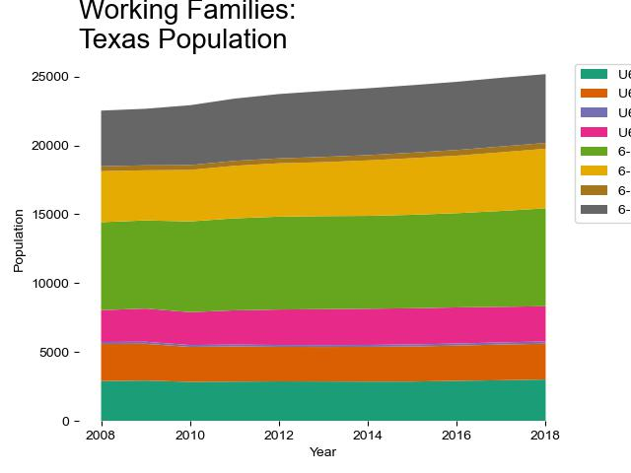
Working Families in Texas
Working families are on the rise.
Single females with children under 6 (pink) remain steady.
Single working mothers with children over 6 (grey) are on the rise.

Slide 9
Conclusion
Cost of Childcare remains constant with the annual income.
With a spike in unemployment, many may still be carrying debt.
The Sales team is primarily composed of females, and they have the lowest rate of attrition.
Single mothers with children over 6 are currently on the rise but the overall population of working families with children remain low.
It’s time to start helping our employees with childcare assistance.
This will help build our female employee rates and provide some relief to our employees.

